Slide 1
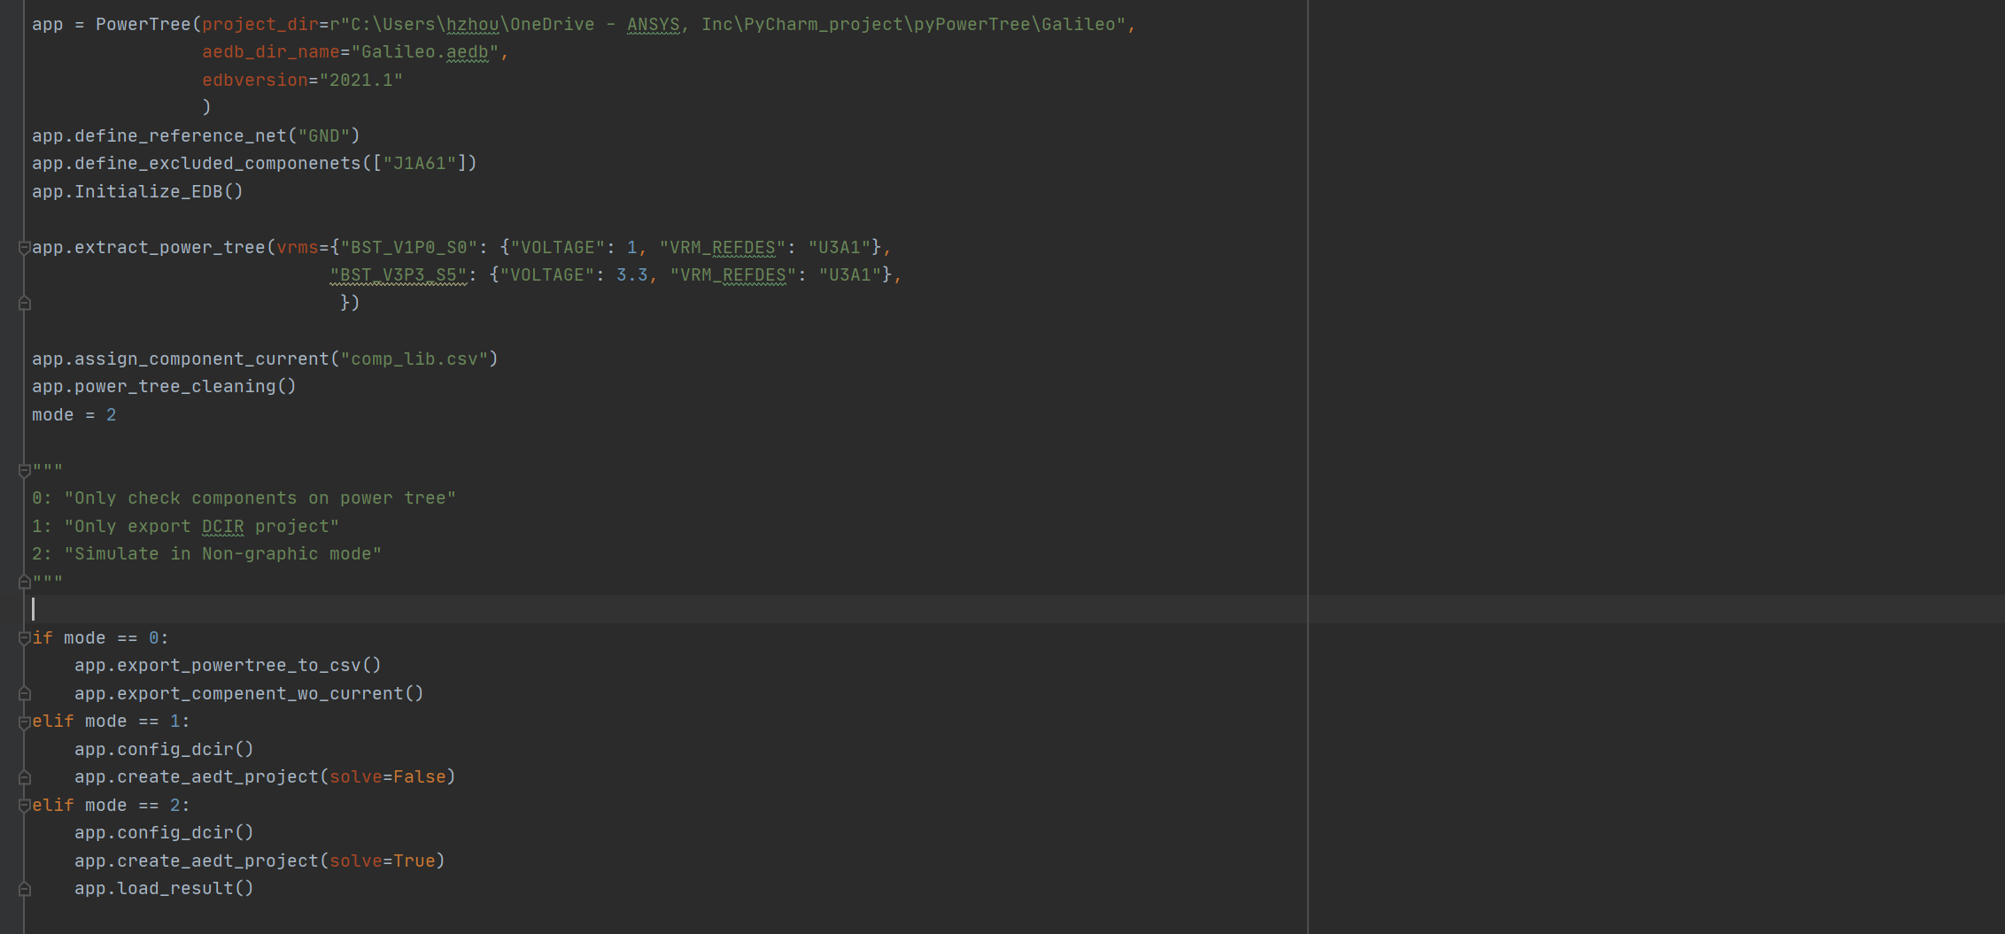
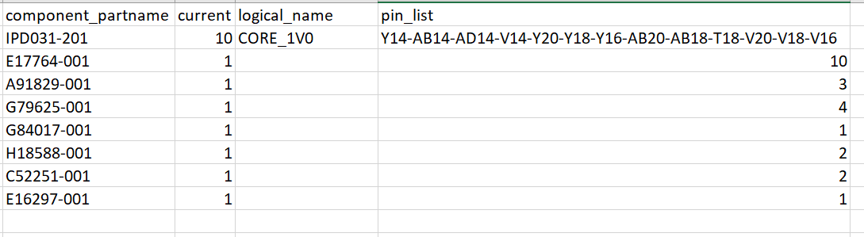
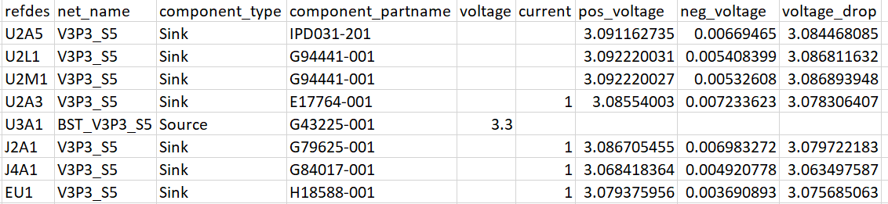
Script Overview and Workflow
VRM output net name
Pin_list is extracted from database
Review components on power tree.
Review components without current assignment
Generate ready to run aedt project for review
Analyze DCIR in non-graphic mode

Slide 2
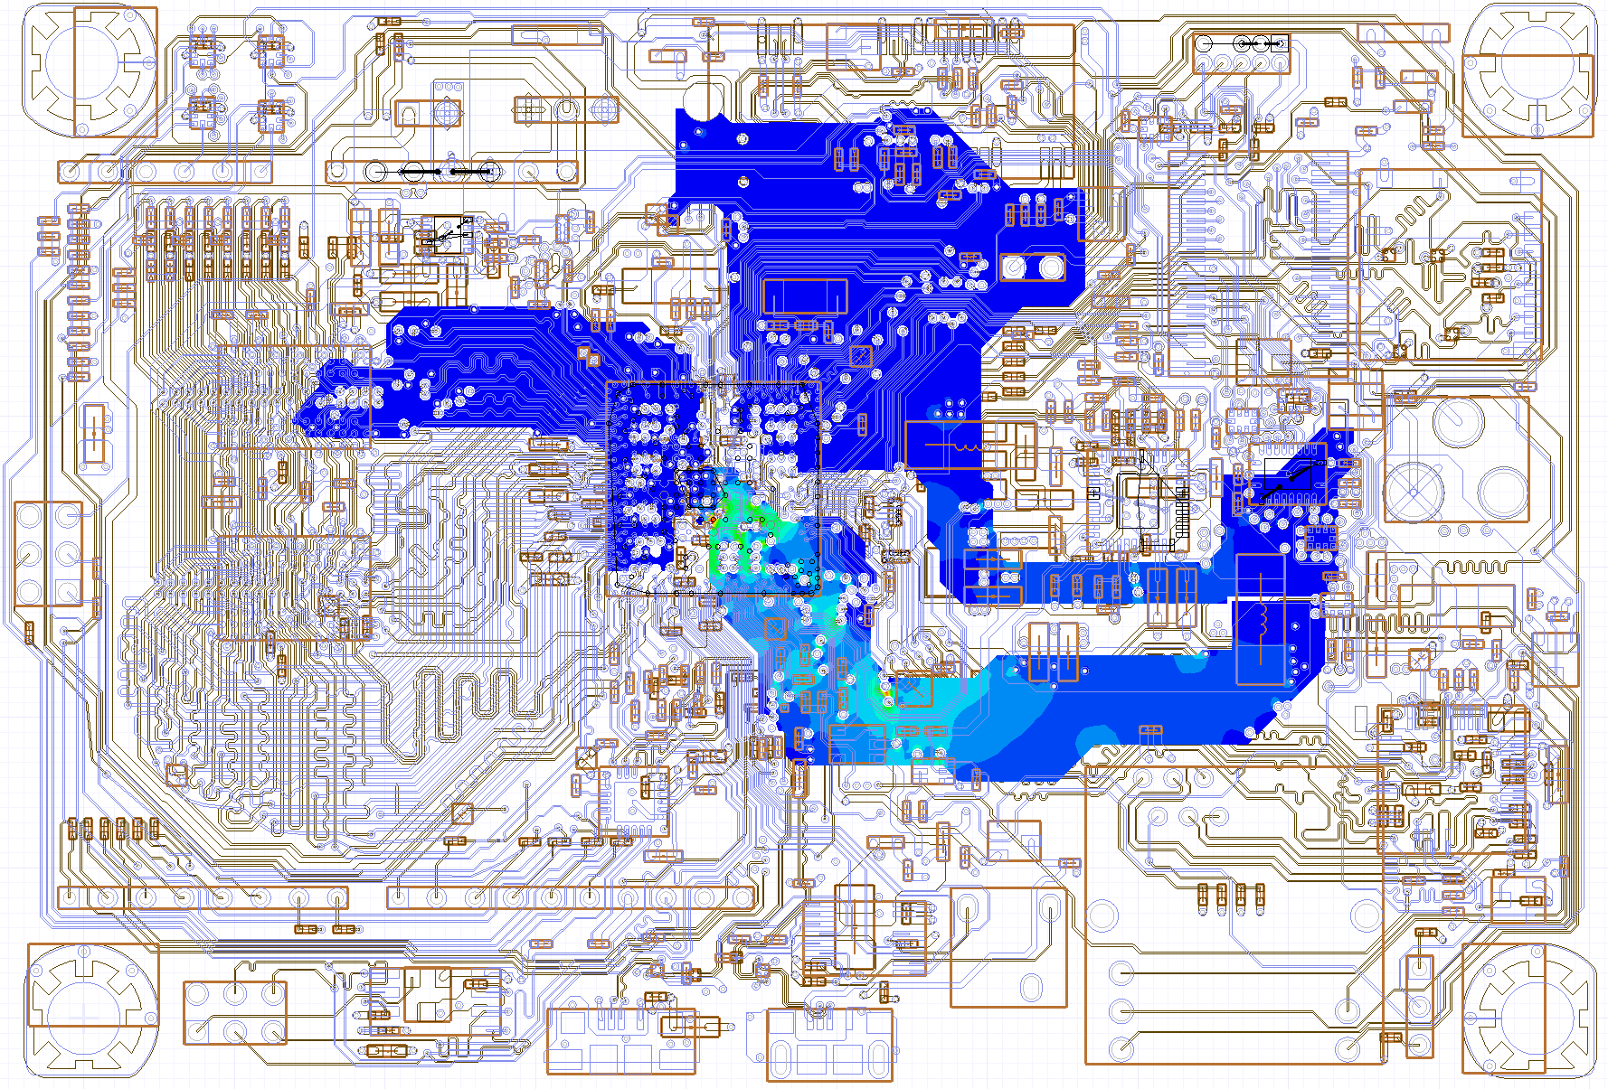
Results
Power tree U3A1-BST_V1P0_S0
AEDT project with results
Power tree U3A1-BST_V3P3_S5
Nets connected by serial inductors

